Slide 1


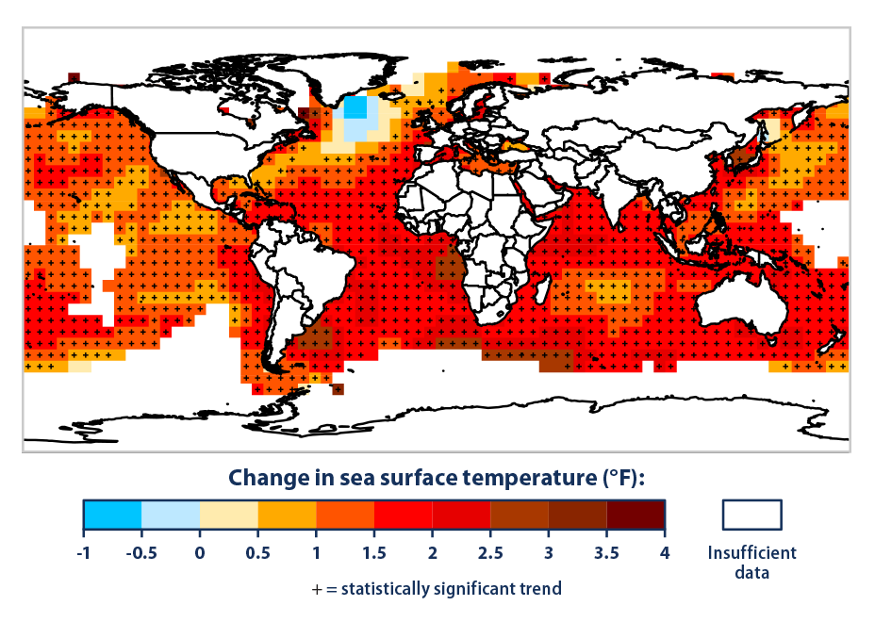
Impact of Temperature and Species Traits on Colonization and Extinction in North American Marine Invertebrates
Cassiel E. Padilla-Durán
University of Puerto Rico at Aguadilla
Zoë Kitchel
Dr. Malin Pinsky
Increase in global surface temperature
Species expand historical latitudinal range

Slide 2
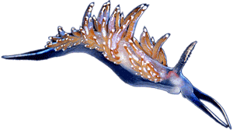

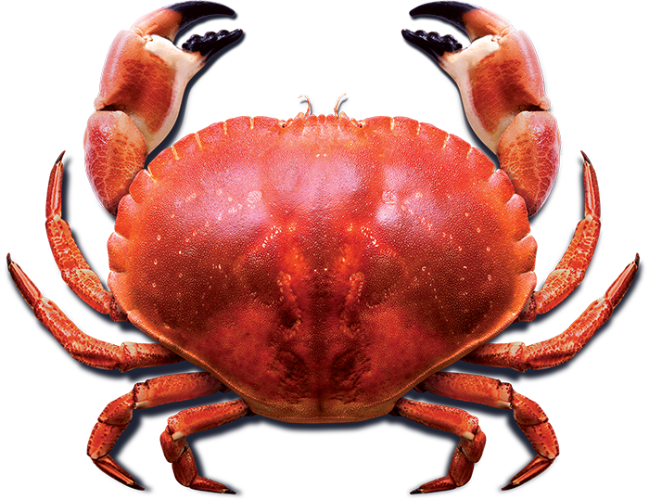



Materials and Methods
2. Data organization: Microsoft Excel
1. Trait data recollection:
154 North American marine invertebrates
3. Data analysis: R programming software
Linear regression
ANOVA

Slide 3
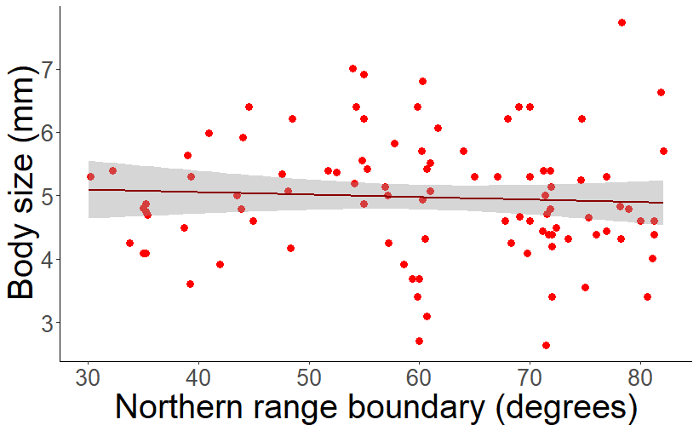

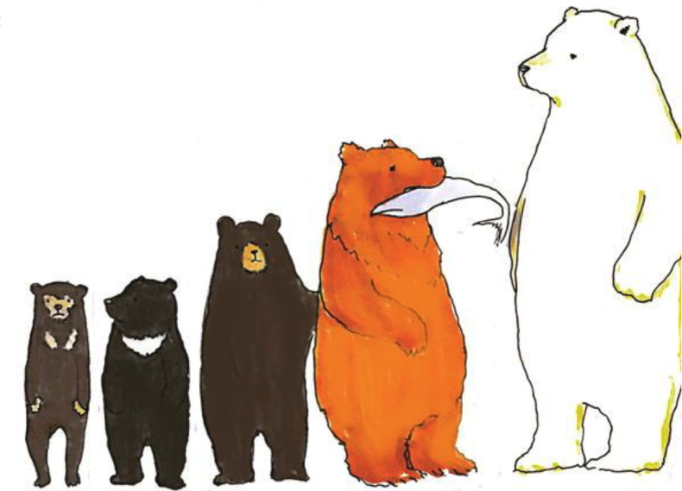
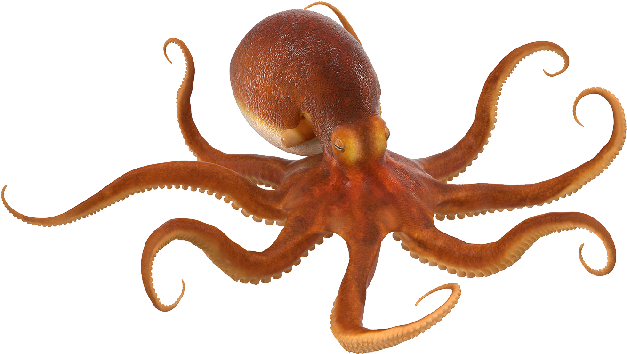

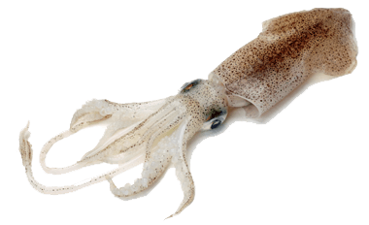
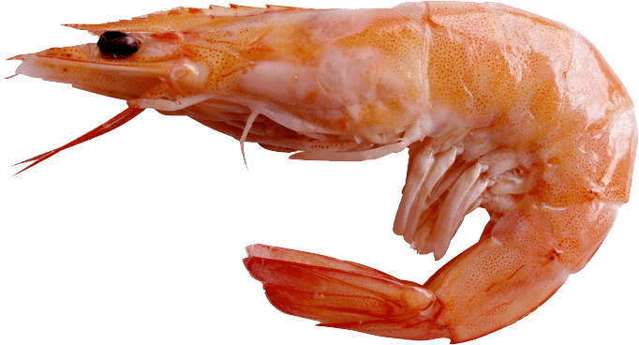
Hypothesis 1:Body size increases with northern range boundary (Bergmann’s rule, 1847)
Hypothesis 1: Rejected
Bergmann’s rule in marine invertebrates
Body size
?
Body size
Result 1: Slight negative but not significant correlation between body size and northern range boundary
Northern range boundary
Bergmann’s rule in land mammals

Slide 4
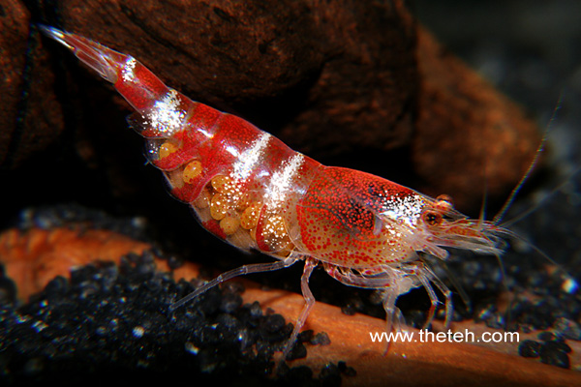
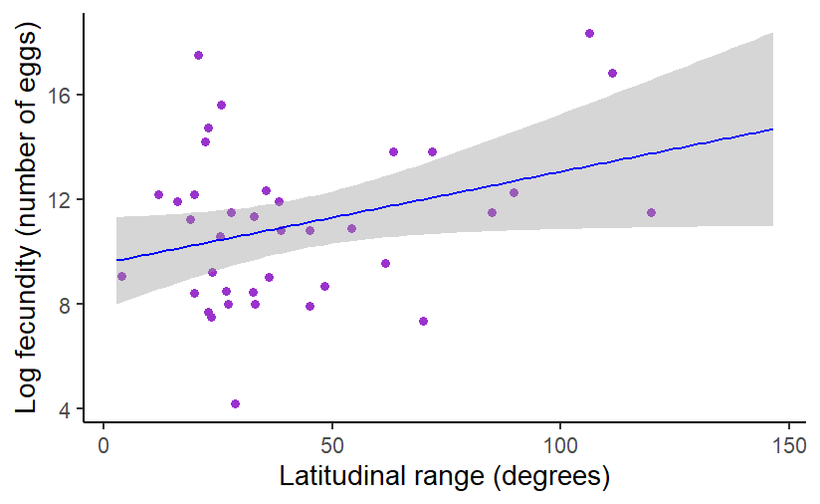
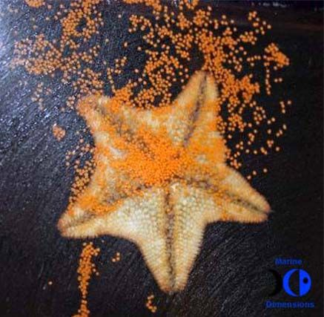
Hypothesis 2: Fecundity increases with latitudinal range size (Winemiller, 1992)
Hypothesis 2: Accepted
Low latitudinal range, fecundity
For every one degree increase in range size, fecundity increases by 3.56% (p = 0.04)
Number of eggs
Latitudinal range
High latitudinal range, high fecundity

Slide 5

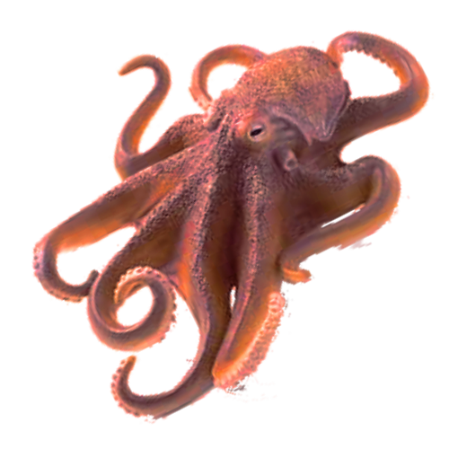
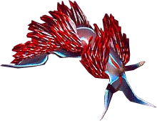
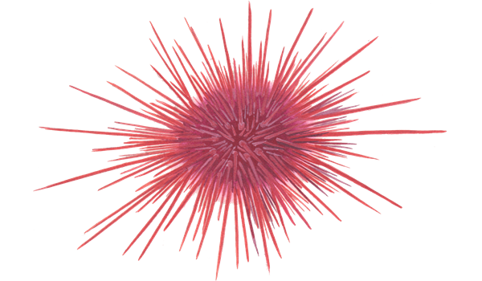
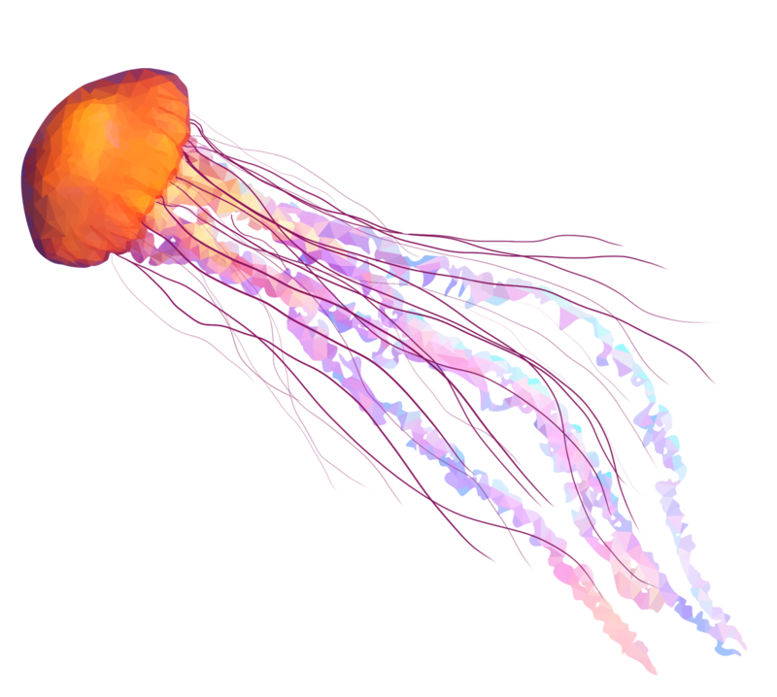
Future Directions
Temperature + Species traits
Colonization or Extinction

